Slide 1
Machine Madness
By: Noah Stracqualursi

Slide 2
Goals
(Printyourbrackets.com)
(Staff, 2020)
1 in 9.2 Quintillion
Predict March Madness games more accurately than the average person
Create a model that doesn’t always choose the higher seed
Create a perfect March Madness Bracket

Slide 3
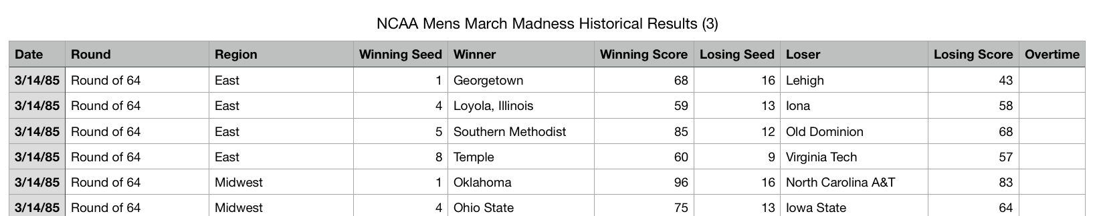
Dataset
Data went from 1985-2016
Included only information from NCAA Mens March Madness Basketball
Focused on Seeds and Teams for most of my analysis

Slide 4
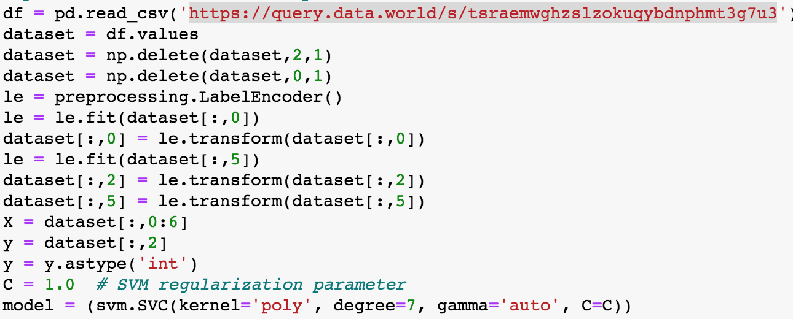
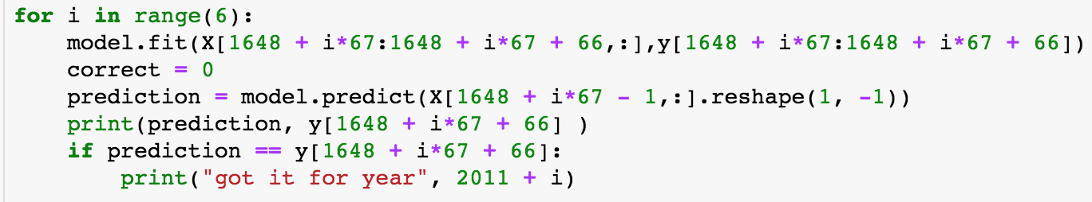
Predicting NCAA Final
Used LabelEncoder: team names and round type
Used all features besides date and region
Used data from 2011 to 2016.
Trained SVM model on all games in the tournament of the year specified and tried to predict who won.
Polynomial degree 7: Random Search

Slide 5
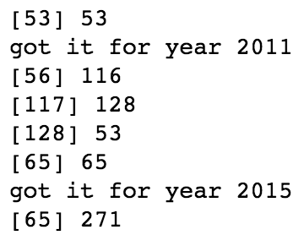
SVM Results
Correct 2/6 years
Average person has about a 50/50 chance
Used data from 2011 to 2016.
SVM model is underperforming

Slide 6
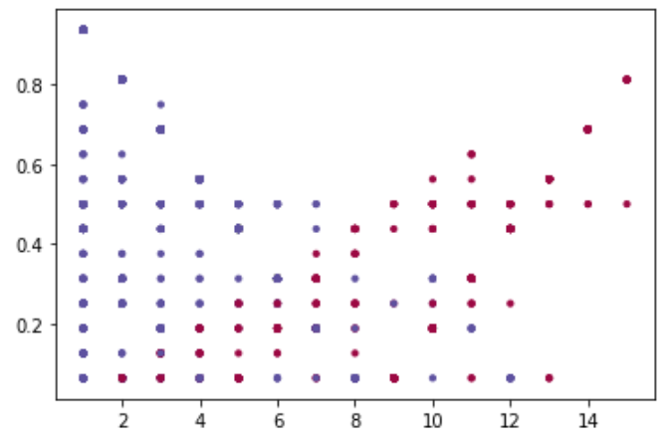
Seeding in March Madness
Blue = higher seed won (closer to 1)
Red = lower seed won (further to 1)
X-Axis = Losing seed
Y-Axis = (seed1 – seed2)²/16
Omits equal seed games
Linearly separable?

Slide 7
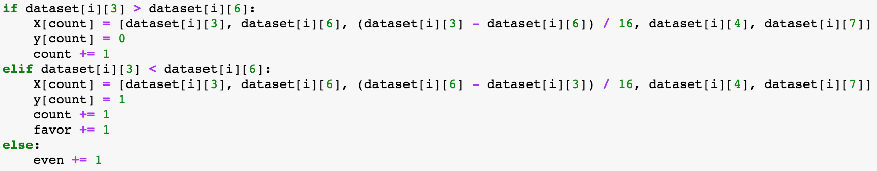
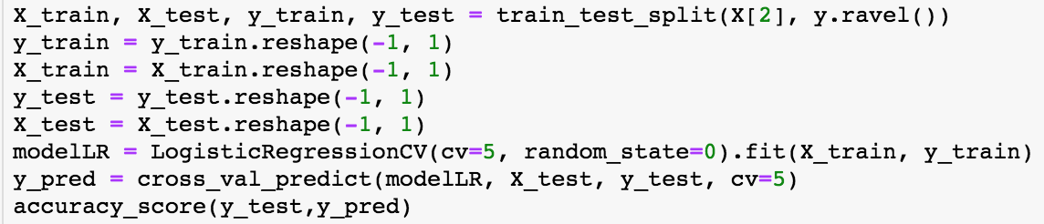
Logistic Regression Cross Validation
X = seed difference algorithm
Y = 1 or 0
Logistic model tried to predict whether or not a game was in favor of the higher seed (y = 1) the lower seed (y = 0).
Model: ≈ 73% accurate
Average win rate of higher seed ≈ 72%

Slide 8
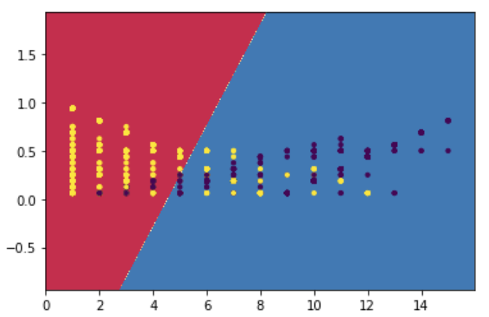
Plotting Logistic Decision Boundary
Linear decision boundary
Same graph as before
X-Axis = Losing seed
Y-Axis = (seed1 – seed2)²/16
Improvement?

Slide 9
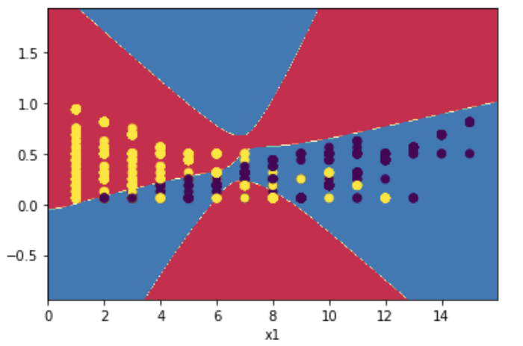
Neural Network 1: Assignment 4
Used code from assignment 4
Hidden layer size 16 (seeds)
Tested num_epoch to find maximum
Accuracy: 77%
Better?

Slide 10
Neural Network 2: MPL
Sklearn package
Solver: Limited-memory Broyden–Fletcher–Goldfarb–Shanno (BFGS)
Activation function: Relu
Used a single hidden layer of size 15
Trained on 80% of the data (scaled)
Tested on 20% of the data
Accuracy: 90%
Best?

Slide 11
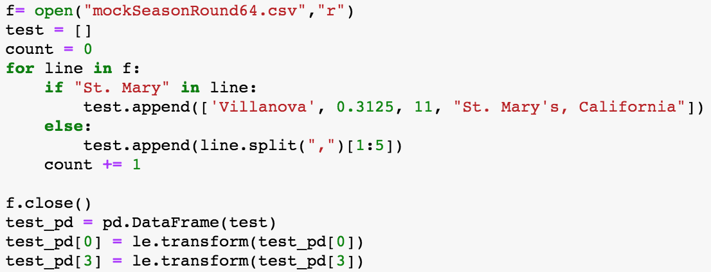
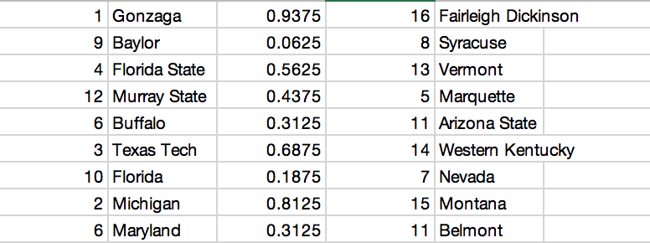
March Madness 2019 Round of 64
Created new dataset
Actual 2019 Round of 64
Features: Seed1, Team1, Diff Alg, Seed2, Team2
Created a pandas data frame
Used same Label Encoder
Issues?

Slide 12
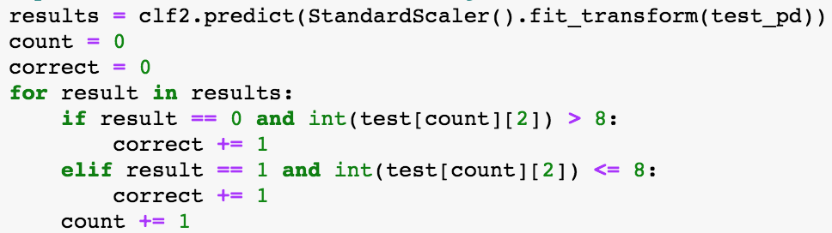
Results of Neural Network 2: MPL
Used same MPLClassifier
Fit classifier on full data set 1985-2016
Tested on 2019 Round of 64 data
Accuracy: 62.5%
Thoughts?

Slide 13
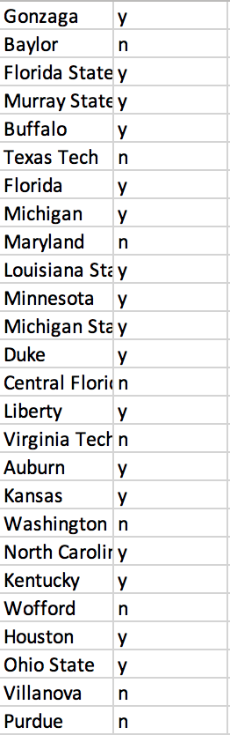
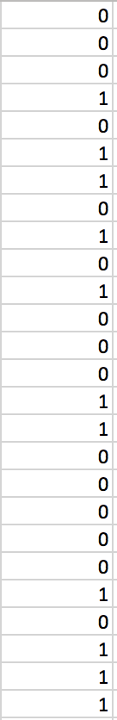
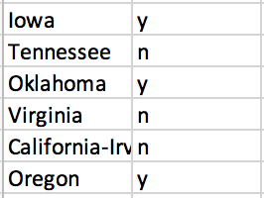
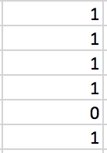
Analysis of Neural Network 2: MPL
Average bracket accuracy 2019: ≈ 41% (Times, 2019)
Model accuracy: ≈ 21% better than the average person
Detected Non-Upsets: Gonzaga (1vs16), Michigan State (2vs15), Houston (3vs14), etc.
Detected Upsets: Murray State (12vs5), Florida (10vs7), Ohio State (11vs6), etc.
Improvement?
Seeding issues?

Slide 14
Final Analysis
SVM: ≈33%
Higher Seed: ≈72%
Logistic Regression: ≈73%
Neural Network 1: 77%
Neural Network 2: 90%
Game Prediction: 62.5%
Achieved: Prediction better than average person
Achieved: Model that doesn’t just choose the higher seed to win the game.
Did not Achieve: Perfect March Madness Bracket
Plausible goal?
Next Steps: Regular Season, Rosters, Full Bracket

Slide 15
Questions
Github Link: https://github.com/noahstrac/MLFinalProject

Slide 16
Resources:
Printyourbrackets.com. (n.d.). Odds of a Perfect Bracket. Retrieved from https://www.printyourbrackets.com/odds-of-a-perfect-bracket.html
Staff, W. (2020, March 12). The Day Sports Shut Down. Retrieved from https://www.wsj.com/articles/ncaa-medical-chief-says-testing-shortage-threatens-march-madness-11584030721
Wilson, C. (2019, April 09). How Our 10 Million Random March Madness Brackets Performed. Retrieved from https://time.com/5566756/march-madness-brackets-random/
Materials from Assignment 2 and 4

